Slide 1

ILLINOIS ASSOCIATION OF SCHOOL NURSES
Poster Presentation Set 1

Slide 2
The Illinois Association of School Nurses
welcomes you to this continuing education offering via enduring poster presentation.
The Illinois Association of School Nurses is an approved provider of continuing nursing education by the Ohio Nurses Association, an accredited approver of continuing nursing education by the American Nurses Credentialing Center’s Commission on Accreditation (OBN-001-91) (OH-001 5-1-2020)

Slide 3
Disclosure:
This Poster Presentation offering was planned and implemented without bias or conflict of interest on the part of the IASN Planning Team or the Presenters.

Slide 4
Directions for Reviewing this Presentation:
Proceed through each of the poster presentations at your own pace.
Take notes about ideas you may use to implement in your practice, so that you can meet this learning activity’s stated behavioral outcome.
Copy the web access link at the end of this presentation into your browser to complete the post activity evaluation.
Print out the Certificate of Activity Completion before submitting your evaluation.
Keep a copy of this certificate for your records.
.

Slide 5
Directions for Reviewing this Presentation
(continued):
Questions? Contact Mary Girardi at: girardi6@comcast.net
For specific dialogue or questions about a particular poster presentation, feel free to contact the author/presenter.
.

Slide 6
Requirements for successful completion of this presentation:
1.00 nursing contact hour will be awarded after viewing 3 posters in this presentation, consider the review questions, and complete the evaluation by following the link to survey monkey.
.

Slide 7
Presentation Goals:
Enhance school nurse participants’ integration of evidence-based solutions for school health and safety.
Provide exposure for school nurse participants to essential concepts related to school populations, enabling school nurses to effectively assess needs and develop meaningful practices that support the school success of students, and support all families within the school community.

Slide 8
Presentation Goals (continued):
Provide school nurse participants with examples of how to describe and summarize evidence- based concepts use in daily practice. Easy, practical, rewarding!
Provide examples of how the NASN Framework for 21st Century School Nursing Practice concept of evidence- based practice can be demonstrated in daily school nursing practice.

Slide 9
Learning Outcome:
Participants will specifically describe how he or she plans to use leadership and EBP to integrate into practice at least one strategy or concept presented in this learning activity into practice pertaining to partnering with school and community, tuberculosis case management, or implementing EBP presented in this learning activity.

Slide 10
Poster Presentation 1
A Model for developing school nursing evidence- based practice guidelines
Robin Adair Shannon MS RN NCSN

Slide 11


Slide 12
Poster Presentation 2
Lessons from lend—family partnerships, collaborative communication, and school nursing
Angela M. Lepkowski MSN RB NCSN

Slide 13


Slide 14
Poster Presentation 3
Tuberculosis in the school setting
Eileen Moss MS RN PEL/NCSN

Slide 15
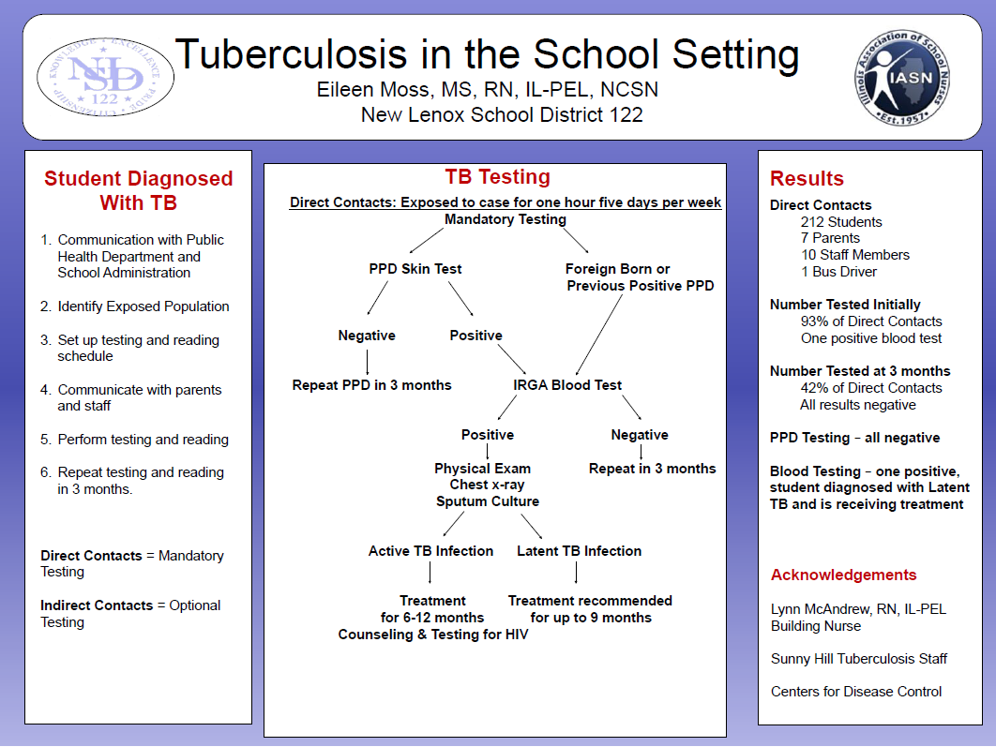

Slide 16
A few questions to help with review and consideration of the presentations:
(this is a continuing education activity after all…)

Slide 17
When grading the strength of recommendations for school nursing
Evidence- Based Practice clinical guidelines, one with minor inconsistencies in quality would be considered:
Strong evidence
Moderate evidence
Limited evidence

Slide 18
Several themes emerged from the Lessons from LEND, however one of the following is not included:
Collaborative communication
Empowerment
Family centered care
Improved coping

Slide 19
In the case study of tuberculosis in the school setting, those with direct contact for one hour five days a week, who initially tested negative were tested again in:
3 months
6 months
9 months

Slide 20
Now that you have reviewed the posters and answered the review questions please follow this link to complete the evaluation:

Slide 21
Thank you for participating in this learning activity!

