Slide 1
Practical Response to Active Shooters

Slide 2
Purpose of Training:
Primary objective is to SURVIVE
Developing a Survivor Mindset
Practical Responses to Threats

Slide 3
Perspective:
Often think only of an active shooter
Expand our definition to include any on-going threat to life
  Knife / edged weapon
  Club or baseball bat / bludgeon
  Any weapon that may cause great bodily harm or death
You have the right to defend yourself and others from threats of death or great bodily harm

Slide 4
Survivor Mindset:
Mentally Prepare – Think ahead
Ask “what if”
Make a Plan – specific to your environment
Positive Visualization
  Always visualize yourself winning

Slide 5
Situational Control
The attacker controls time, location, and method of attack.
What we can control:
  We can deny the attacker victims
  We can harden ourselves as a target
  We can decide whether or not we fight back
  We can disrupt the attacker’s plan

Slide 6
Practical Responses:
Evacuation
Shelter-in-Place/Lockdown
Prepare to fight back
Fight back
What to do when police arrive

Slide 7
Evacuation:
Always move away from the sound of gunfire
Assume it is gunfire : react
Do not wait or assume it was nothing
Do not waste time. Get away from the building or area where the shooting is occurring
If you are confronted with attacker, act ….
  Do something
Notify the police

Slide 8
Shelter-in-Place/Lockdown:
Lock the door if possible
Barricade with room contents and seek cover
Attackers have a limited time and are looking for easy targets
Look for Cover
  Concealment: Hides you from a person
  Cover: May hide you from a person and provides protection from bullet penetration

Slide 9
Shelter-in-Place cont.
Direct others to move to a spot in the room that cannot be viewed through the doorway
Try not to bunch together too closely
Turn off the lights
Notify police if able, local police may be overwhelmed with calls but keep trying

Slide 10
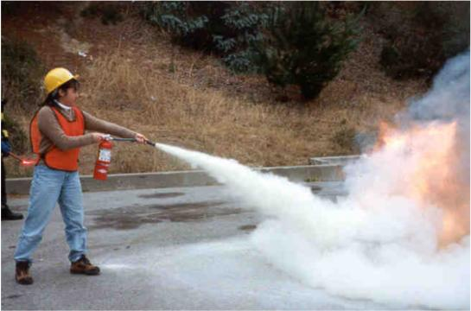
Prepare to fight back:
Ordinary items that can be used as weapons
  Books, stapler, chair, fire extinguisher, pencil, keyboard, keys
Create a plan of attack
  Ask for volunteers
  Assign tasks

Slide 11
Fight Back to Escape
Throw items at the attacker to distract
Push past or strike at the attacker
Run away from the attacker
Escape away from the danger zone
Don’t stop

Slide 12
Fight back:
Throw items at the attacker, attempting to distract
Immediately follow up with an attack
Make every attempt to control the barrel of the weapon – point it toward the ground
Attack quickly and violently – 100 percent force
Attack his eyes, throat, nose, groin, head

Slide 13
Fight back cont.
You are in a fight for your LIFE !!!!
Hang onto the attacker
  Overwhelm him with people
  Remove the weapon and place in opposite corner if possible
  Place weapon on floor and have someone stand on or near weapon

Slide 14
Police arrival:
Police will announce their presence and will usually be in a group
Show your hands – hands hold weapons
Never run toward police or yell at them
One person speaks for group
Listen to their commands
  Evacuate at police request
  Stay in place

Slide 15
Police arrival cont.
If you have taken control of the attacker
  Hold on to him or her even after the police enter the room
  Everyone else should place their hands in the air with palms facing out
  One person should explain the situation to the police
Do NOT hold the weapon when police arrive

Slide 16
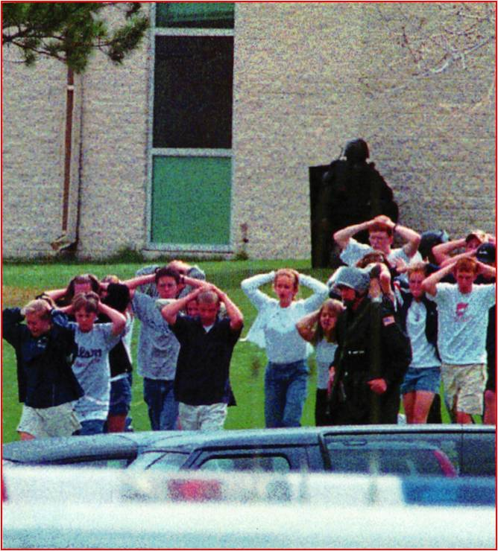
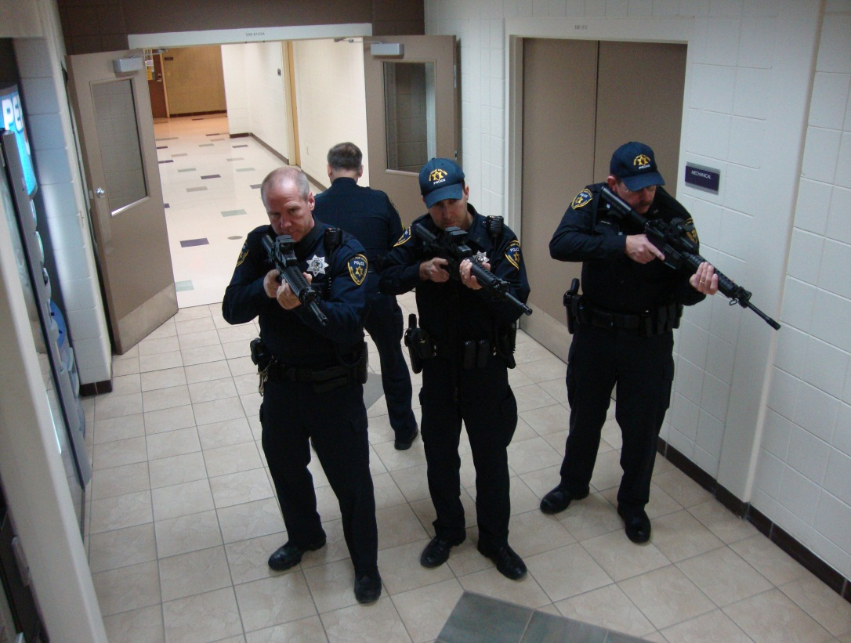

Slide 17
Summary:
Survival Mindset – develop plans
Evacuate / Escape
Shelter-in-Place / Lockdown / Barricade
Fight Back to Escape
Police Arrival Process
SURVIVE

Slide 18
Questions?
Notes:
What questions do you have for us?

