Slide 1
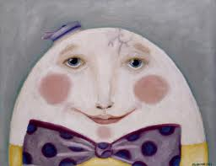
Headaches in school children
Jeffrey S Royce MD, FAAFP, FAHS
Clinical Assistant professor
University of Illinois College of Medicine at Rockford

Slide 2
Disclosure Statement
This conference is being presented without commercial bias or conflict of interest on the part of the presenters, the conference planning committee or IASN. Various products and services displayed in the vendor area are not endorsed by IASN or any member of the conference planning committee.

Slide 3
Disclosure
Speaker Bureau
Allergan
Depomed
Advisor
Avanir

Slide 4

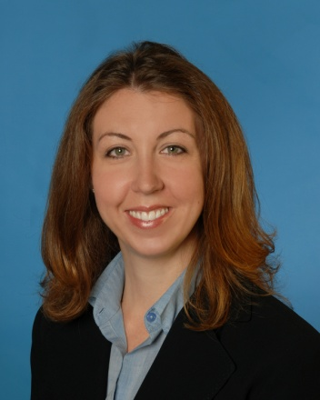
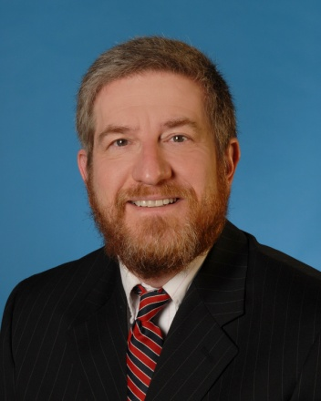
Swedishamerican neuro and headache center
Jeffrey Royce MD, FAAFP, FAHS, Board certified headache specialist
Mary Zingre PA-C, Physician assistant
Nesher Asner MD, Board certified neurosurgeon

Slide 5
Outline
Epidemiology
Migraine and the primary headaches
Red flags
Acute headache treatment
Impact of headache
Abdominal migraine
Concussion and headache

Slide 6
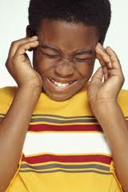
Prevalence of headache in children
Age 3: 3-8%
Age 5-7: 19%
Age 7-15: 57-82%

Slide 7
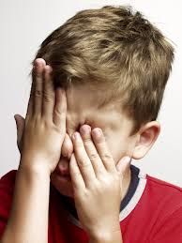
Prevalence of migraine through childhood
Age | 3-7 yr | 7-11 yr | 15 yr
prevalence | 1.2-3.2% | 4-11% | 8-23%
Gender ratio | B>G | B=G | G>B

Slide 8
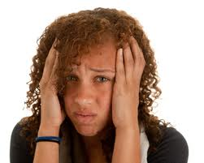
Primary Headache Disorders
Migraine without Aura
Migraine with Aura
Cluster Headache
Tension-Type Headache

Slide 9
Migraine Without Aura
Formerly Common Migraine
IHS criteria, pediatrics—Pain characteristics (at least 2 required)
Unilateral pain or bilateral or frontotemporal (not occipital)
Throbbing/pulsating
Moderate to severe in intensity
Worsened by physical activity
Headache Classification Committee IHS, Cephalalgia 2013

Slide 10
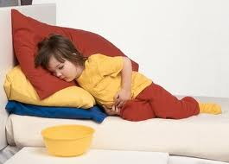
Associated Characteristics
One required:
Photophobia and phonophobia (pediatrics, may be inferred by behavior)
Nausea or vomiting
Duration of 2-72 hours

Slide 11
ID Migraine
PIN
Photophobia
Impairment
Nausea
Yes to 2/3 of these sx’s gives an 81% probability of migraine
Presence of all 3 portends a 93% probability
Lipton RB, Neurology 2003

Slide 12
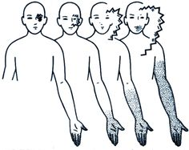
Aura
Focal neurologic symptoms that precede or accompany a migraine headache
Only 24-43% of migraineurs have aura
Only 10% of migraine with aura patients have the aura with every headache

Slide 13
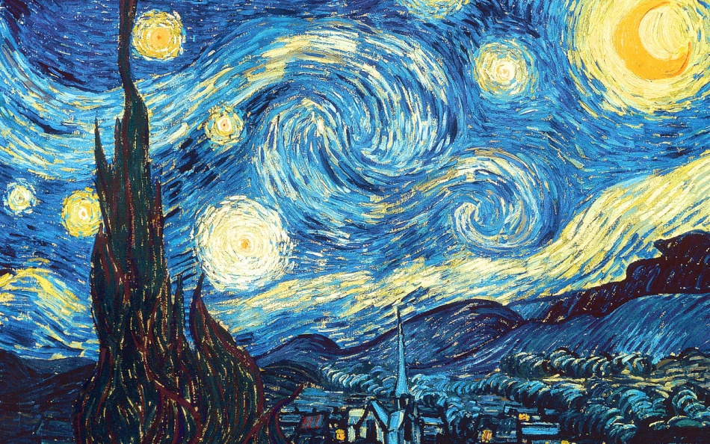
Aura
Symptoms develop over 5 or more minutes
Lasts less than 60 minutes
The headache appears before the end of the aura or more commonly up to 60 minutes after

Slide 14
2013 Migraine with aura powerful predictor of Cardiovascular events
New findings of the Women’s Health study: migraine with aura is, after hypertension, the strongest predictor of the risk of stroke and heart attack
1400 woman suffered from Migraine with aura
During 15 year follow-up 1000 had a heart attack, stroke or died of CVD

Slide 15
Aura Symptoms
Visual: flickering lights, dark spots (scotoma), or wavy or jagged lines (79-99%)
Sensory: pins and needles, followed by numbness (30-40%)
Face, lips, tongue
Hands and arms
Speech disturbance (9-20%)

Slide 16
Neck pain commonly occurs in migraine attacks

Slide 17
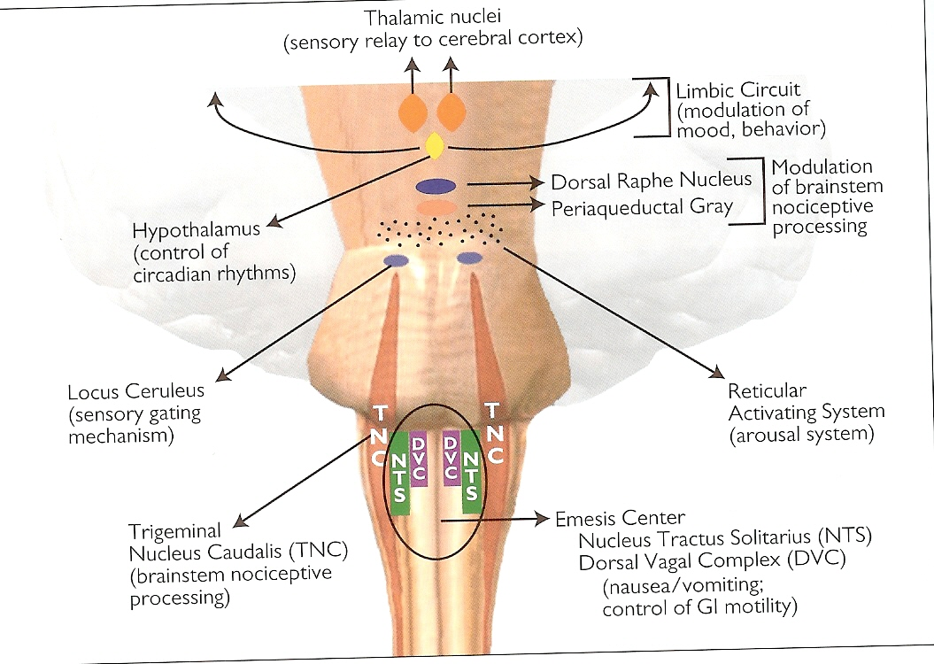
Cervical Pain in migraine
C2
C3
Trigeminocervical complex

Slide 18
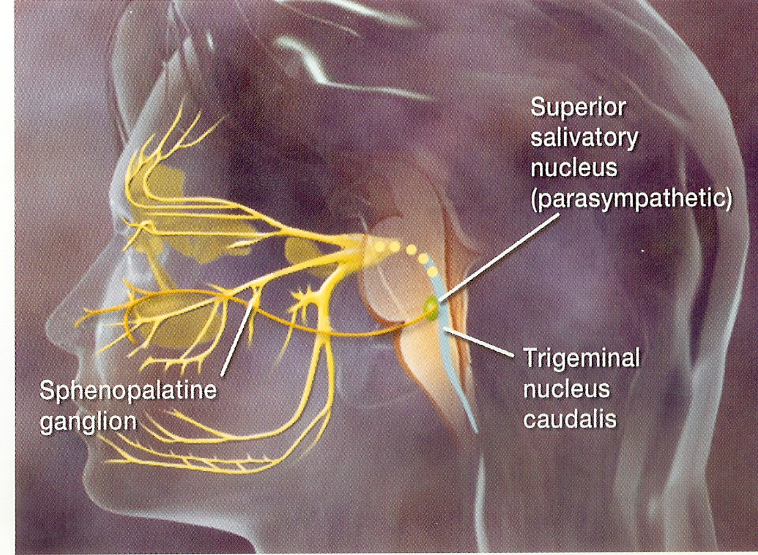
Sinus Symptoms
Migraine activation of the TNC can lead to cranial PSNS activation thus causing:
Rhinorrhea
Congestion
Lacrimation

Slide 19
Sinus Headache
NOT a primary headache disorder
Secondary diagnosis arising from acute bacterial sinusitis
Associated with the symptoms of:
Purulent nasal drainage
Facial pain
Congestion
fever

Slide 20
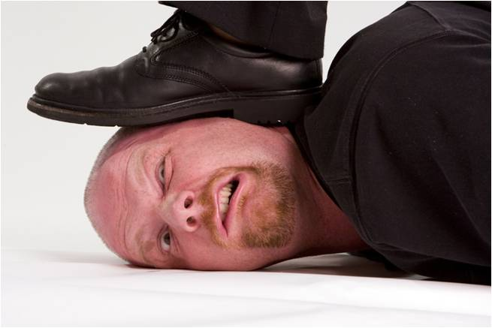
Tension Type Headache
Bilateral location
Pressure, tightening character (nonpulsating)
Mild to moderate pain
May inhibit but not prohibit activity

Slide 21
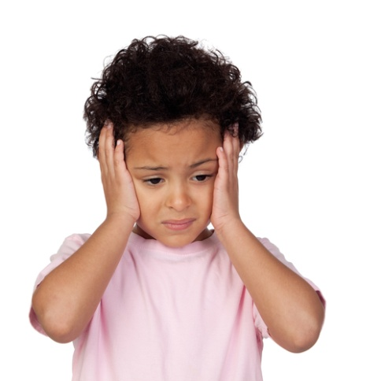
Tension Type Headache
Not aggravated by routine physical activity
No nausea nor vomiting
Minimal light or sound sensitivity (not both)
Lasts 30 minutes to 7 days

Slide 22
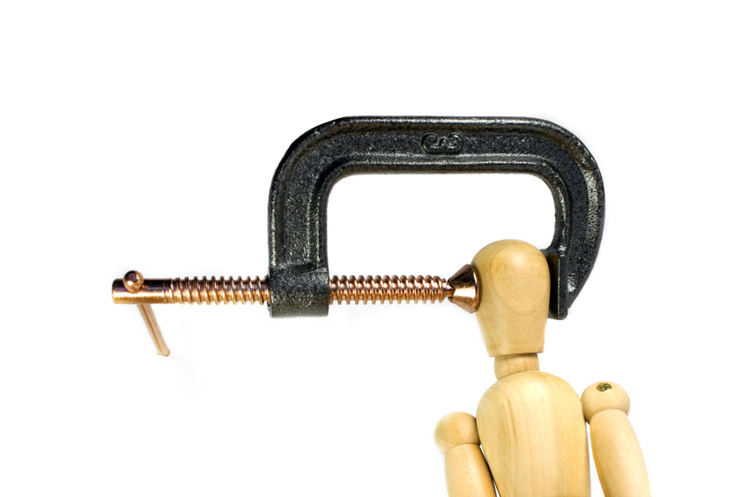
Tension Type Headache
Episodic type occurs less than 15 days per month
May be triggered by insomnia, stress, fatigue, fever, hunger, odors, and red wine
NOT caused by:
Emotional stress
Muscle tension
Muscle contracture

Slide 23
Medication Overuse Headache
Diffuse bilateral daily headache
Aggravated by mild exertion
Onset with awakening or in the early morning
No response to preventive therapy
Tolerance to acute abortive medications

Slide 24
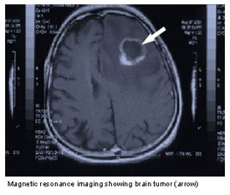
Worrisome Headaches

Slide 25
Red Flags-Ominous signs
First or worse headache—unusual severity
Sudden or rapid escalation within minutes
Mental status changes
Onset during exercise
Posterior radiation below the neck
Stiff neck
Onset after 50 y/o or less than 5 y/o
Abnormal neurological examination

Slide 26
Red Flags
Associated constitutional symptoms
Fever
Weight loss
Recent infection
Change in character or frequency of existing headache
Refractory to two different therapies

Slide 27

Pediatric Red flags
Head trauma
Toxic exposure
Presence of a shunt
Café au lait spots, petechiae, hypopigmentation

Slide 28
Goals of acute therapy
Relieve pain quickly and completely
Relieve associated symptoms
Return to normal functioning
Reduce socioeconomic costs
Improve quality of life
Prevent recurrence

Slide 29
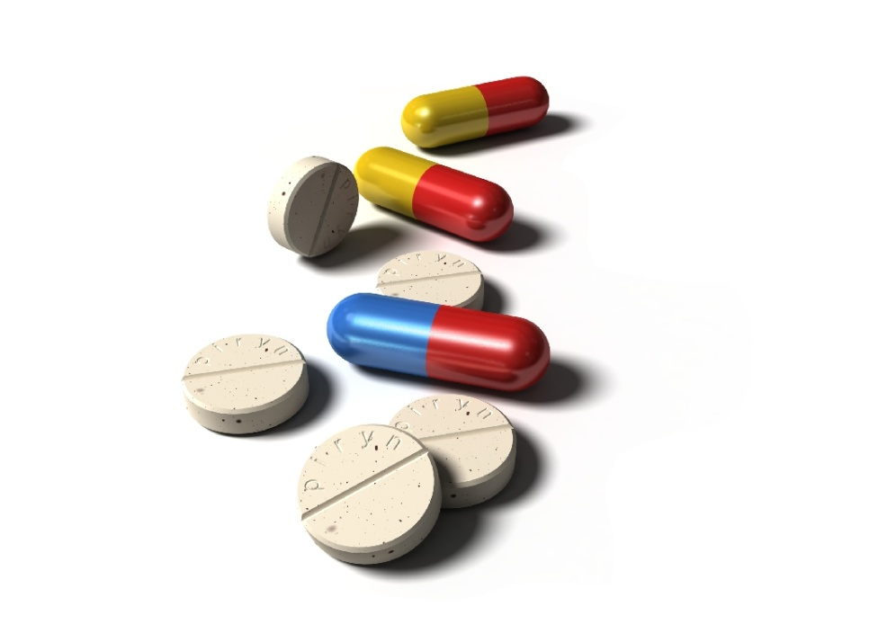
Acute medications
Acetamenophen 15 mg/kg every 4 hours
Ibuprofen 10 mg/kg every 6 hours
Benadryl 5 mg/kg/24 hr divided every 6 hrs
Caffeine 50 mg

Slide 30
Analgesic use limit (palm Beach headache center)
No more than 10 tablets of analgesic per month for a young child
No more than 20 tablets per month for an adolescent
No more than 2 headaches treated with these parameters per week
Headache in Children and Adolescents 2nd Ed., Winner et al. 2008

Slide 31
Oral NSAIDS (adult) Group 2 US Headache Consortium 2000
Fenoprofen (Nalfon) 600 mg TID prn
Flurbiprofen (Ansaid) 100 mg BID prn
Ketoprofen (Orudis) 75 mg TID prn
Mefenamic acid (Ponstel) 250 mg QID prn
Naproxen 500 mg BID
Naproxen Sodium 550 mg BID
Diclofenac 50 mg oral suspension (Cambia)

Slide 32
The Triptans
Sumatriptan –Imitrex
Naratriptan—Amerge
Zomatriptan—Zomig
Rizatriptan—Maxalt
Almotriptan—Axert
Frovatriptan—Frova
Eletriptan--Relpax

Slide 33
Rizatriptan
Pediatric indication 2010 age 6 to 17 years
5 mg dosage for children weighing less than 40 Kg
If child the <40 Kg is taking propranolol rizatriptan is contraindicated
10 mg for children greater than 40 Kg
If the >40 Kg child is taking propanolol the rizatriptan dose is 5 mg

Slide 34
Almotriptan
Pediatric indication 2009 for ages 12-17 years
Initial dose 6.25 mg or 12.5 mg
May repeat in 2 hours

Slide 35
Side Effects
Tingling
Warmth
Chest heaviness
Dizziness
Flushing
Neck and throat tightening
Somnolence
Fatigue
Dry mouth
Nausea

Slide 36
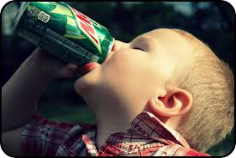
Headache triggers

Slide 37
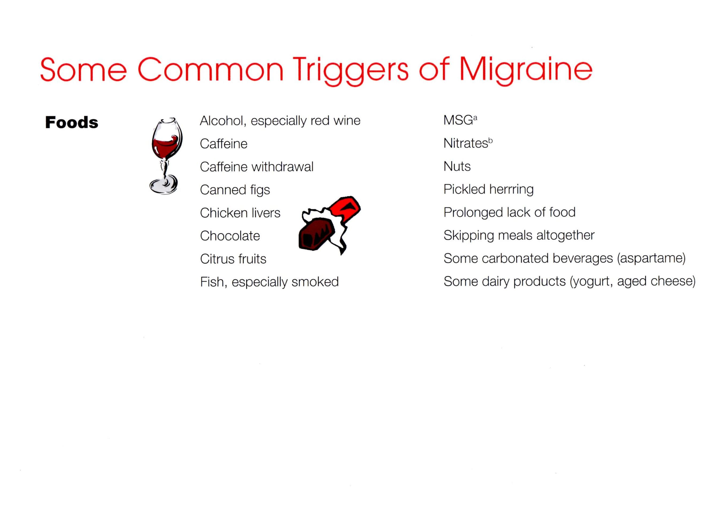
obesity

Slide 38
Other Therapies
Biofeedback
Cognitive behavior therapy
Meditation & relaxation
Visualization
Yoga
Exercise
Therapeutic blocks
Massage
Acupuncture

Slide 39
Social/work/school Impact (over 3 months)
25.3% Missed one day of work/school
28.1% Work/school productivity <50%
Average of 3 days lost work day equivalents
29.1% Missed family/social activity
47.7% Did no housework
Lipton RB, Neurology 2007

Slide 40
Children with Migraine: Missed school days
2.75 million school days missed per year
Stang PE and Osterhaus JT. Headache 1993;33
Cady RK Headache 1996;7

Slide 41
Abdominal migraine
Up to 12% of school children aged 3 to 15 years with recurrent attacks of abdominal pain
Peak age of onset 10 years
The pain is midline, periumbilical and poorly localized
The character is dull or sore
Severity is mild to moderate lasting 2-72 hours
Complete resolution between attacks

Slide 42
Abdominal migraine
Associated features
Pallor
Lethargy
Anorexia
Nausea, vomiting (less common)
Headache attacks occur later in life for 31-50%
1/3 have attacks in adolescence or early adult life

Slide 43
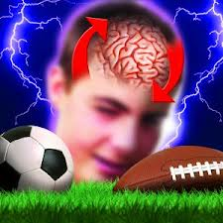
Concussion

Slide 44
Stats: Epidemiology
Estimated 1.6 to 3.8 million sports related traumatic brain injuries/year in the US
Half of the concussions are not noticed and unreported
Concussions account for 9-13% of all sports related injuries

Slide 45
Concussion definition
Complex neurologic changes affecting the brain induced by trauma.
Caused by a direct blow to the:
head itself or
the body with traumatic forces transferred to the head
Most do not involve loss of consciousness
Mild end of the traumatic brain injury spectrum.

Slide 46
Physical Symptoms
Headache
Nausea
Vomiting
Balance problems
Dizziness
Visual problems
Fatigue
Sensitivity to light
Sensitivity to sound
Numbness/tingling

Slide 47
Cognitive Symptoms
Feeling mentally foggy
Feeling slowed down
Difficulty concentrating
Difficulty remembering

Slide 48
Emotional symptoms
Irritability
Sadness
More emotional
Nervousness

Slide 49
Sleep symptoms
Drowsiness
Sleeping less than usual
Sleeping more than usual
Trouble falling asleep

Slide 50

Treatment of concussion
Physical and cognitive rest
Limit exposure to bright screens
Television
Cell phone
Computer
Lighter work or school load
Minimal medications
Encourage good sleep hygiene

