Slide 1
You Don’t Have to Be An Artist to Express Yourself
Presenter – Deb Schwarze, LCPC
MS – Art Therapy MA – Counseling
Expressive Arts Therapist and Caring Canines Coordinator – SwedishAmerican Health System- Rockford, Illinois

Slide 2
What IS Art Therapy?
According to the American Art Therapy Association, art therapy is “a mental health profession that uses the creative process of art making to improve and enhance the physical, mental and emotional well-being of individuals of all ages. It is based on the belief that the creative process involved in artistic self-expression helps people resolve conflicts and problems, develop interpersonal skills, manage behavior, reduce stress, increase self-esteem and self-awareness, and achieve insight”.

Slide 3
Where is Art Therapy Used?
Medical facilities
Outpatient therapy offices
Long term care facilities
Mental health facilities
Schools

Slide 4
Why Art?
For people of all ages, there are some events and experiences for which we have no words
Expressive therapies help us tap into the unconscious and help us express our hidden and/or buried emotions and thoughts

Slide 5
But I Can’t Draw
It REALLY doesn’t matter
All of us are creative
Because we are unique individuals, we show our creative sides in different ways
As with any effective counseling experience, expressive therapies are designed to fit the individual’s needs and strengths

Slide 6
What Kind of Art Making Is Used In A School Setting?
There are truly no limits as to what can be utilized
Supplies can range from a box of crayons and a piece of paper to elaborate art studios

Slide 7
Expressive Therapies Involve More Than Drawing Pictures
In addition to drawing or painting, expressive therapists can utilize:
  Journaling
  Music
  Drama
  Photography
  Writing stories
  Gardening
  Animals
  Etc, etc, etc

Slide 8
Why Does It Work?
According to Hass-Cohen & Carr (2008) and Lusebrink (2004), experiential therapies using motor activity (moving a crayon, paint brush, scissors, etc) stimulate and strengthen connections between the brain’s subcortical regions and the neo-cortex (bottom-up approach) OR cognitive challenges (trying to figure out how to manipulate the art making tools) activates and strengthens the connections between the neocortex and subcortical regions of the brain (top-down) approach

Slide 9
The Less Technical Reasons Why It Works….
Creating something triggers the pleasure centers of the brain
The distraction of focusing on the art makes it easier to talk
The creative process helps foster a sense of mastery
The focus can be on the “process” rather than the “product”

Slide 10
Types of Art Supplies Used and Their Possible Meanings
When a variety of choices are given, the choice of art media that the student makes, may be indicative of their emotional state

Slide 11
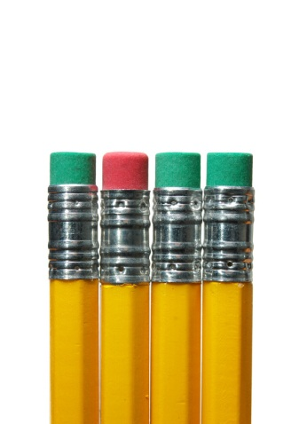

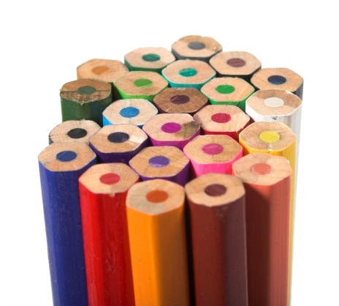

What Do You Think These May Say?

Slide 12
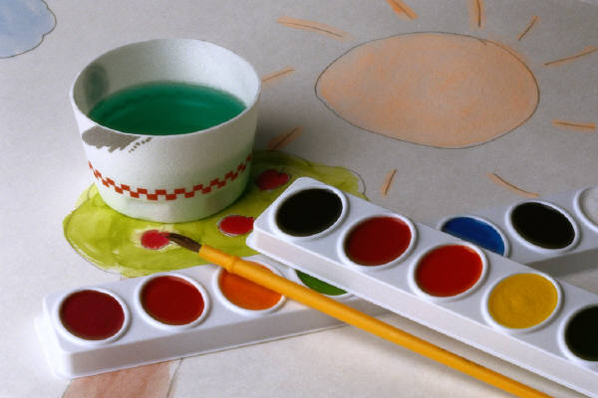
Use With Caution….

Slide 13
Non-Threatening for Most Everyone

Slide 14


Expressive Art Journaling

Slide 15
Designed Project VS Free Form Art
Many Opinions
An Art Therapist would look at what is most beneficial for the student/client

Slide 16

As A Nurse in School Setting, How Does This Apply to Me?
You have the advantage of interacting with students in a very different manner than other adults in their lives

Slide 17
What Can I Do?—Make Referrals
Students with attention difficulties may benefit from the different type of focus that art brings
Students with cognitive deficits may benefit from utilizing the creative, right side of the brain
  Expressive arts also can allow students to “talk without words”
Motor skills can be practiced

Slide 18

Life As An Art Therapist in a Public School Setting
Rural eastern Oregon School district of about 4000 students
Employed as a behavior specialist in the Special Education Department to work at four elementary schools
Designed and implemented the ABLE (Assisted Behavior Learning Environment) Program

Slide 19
Stories…..
Due to confidentiality, I can’t talk about specifics, but some examples include
  “Jane” and her abuse drawing
  “Bobby” and the dog
  Comfort Rooms and art
  “John” and the healing process

Slide 20
Summary
Expressive arts therapy involves much more than drawing a picture
It includes many forms of non-verbal self expression
It touches our lives in ways that we are just beginning to understand

Slide 21
Let’s Use That Creative Right Side of the Brain!
Supplies are on your table
Let’s have some fun!
Questions

Slide 22
Thank You

